Slide 1
Lesson 13: UML Fundamentals（4）:
State Machine, Activity, Component,
Deployment Diagram
13.1 State Machine Diagram
13.2 Activity Diagram
13.3 Component Diagram / Artifact
13.4 Deployment Diagram

Slide 2
13.1 State machine Diagram
Definition
State
Transition
Event
Action
…………….

Slide 3
13.1.1 Definition -Statechart / State Machine
  A behavior that specifies the sequences of states an object goes through during its lifetime in response to events, together with its responses to those events.
Common purpose
  To model the lifetime of an object and help to test, debug and describe the dynamic behavior
  Object → class, use case, the whole system

Slide 4
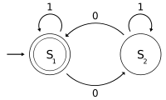
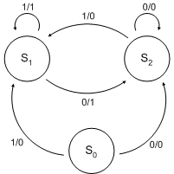
13.1.1 History of State Machine
State diagram is a type of diagram used in computer science and related fields to describe the behavior of systems
Moore Machine
Mealy Machine
The input is denoted on each edge
Input and output are signified on each edge, separated with a slash "/":
The triggered action is related to the state
The triggered action is related to the transition

Slide 5
13.1.1 History of State Machine
Harel statechart, which allows modeling of
  Superstates
  Orthogonal regions
  Activities as part of a state
UML statechart – A variant of Harel statechart
  Hierarchically nested states
  Extending the notion of action
    Depend on both the state of the system and the triggering event → Mealy Machine
    Entry and exit actions, which are associated with states → Moore Machine
Notes:
Harel statecharts[5] are gaining widespread usage since a variant has become part of the Unified Modeling Language (UML). The diagram type allows the modeling of superstates, orthogonal regions, and activities as part of a state.
Superstate: 超状态，说明 状态是可以嵌套的，有superstate,也可以有substate
Classic state diagrams require the creation of distinct nodes for every valid combination of parameters that define the state. This can lead to a very large number of nodes and transitions between nodes for all but the simplest of systems (state and transition explosion). This complexity reduces the readability of the state diagram. With Harel statecharts it is possible to model multiple cross-functional state diagrams within the statechart. Each of these cross-functional state machines can transition internally without affecting the other state machines in the statechart. The current state of each cross-functional state machine in the statechart defines the state of the system. The Harel statechart is equivalent to a state diagram but it improves the readability of the resulting diagram.
Hierarchical state decomposition can be viewed as exclusive-OR operation applied to states. For example, if a system is in the "on" superstate (Figure 3), it means that it's either in "operand1" substate OR the "operand2" substate OR the "opEntered" substate OR the "result" substate. That is why the "on" superstate is called an OR-state.
UML statecharts also introduce the complementary AND-decomposition. Such decomposition means that a composite state can contain two or more orthogonal regions (orthogonal means independent in this context) and that being in such a composite state entails being in all its orthogonal regions simultaneously.^{[8]}
Orthogonal regions address the frequent problem of a combinatorial increase in the number of states when the behavior of a system is fragmented into independent, concurrently active parts. For example, apart from the main keypad, a computer keyboard has an independent numeric keypad. From the previous discussion, recall the two states of the main keypad already identified: "default" and "caps_locked" (see Figure 1). The numeric keypad also can be in two states—"numbers" and "arrows"—depending on whether Num Lock is active. The complete state space of the keyboard in the standard decomposition is the Cartesian product of the two components (main keypad and numeric keypad) and consists of four states: "default–numbers," "default–arrows," "caps_locked–numbers," and "caps_locked–arrows." However, this is unnatural because the behavior of the numeric keypad does not depend on the state of the main keypad and vice versa. Orthogonal regions allow you to avoid mixing the independent behaviors as a Cartesian product and, instead, to keep them separate

Slide 6
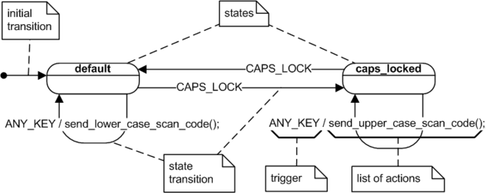
13.1.1 An example of State Machine
State：default, caps_locked
Transition：CAPS_LOCK; ANY_KEY/ send_lower_case_scan_code()
Event: CAPS_LOCK; ANY_KEY
Action: send_lower_case_scan_code();
send_upper_case_scan_code();

Slide 7
13.1.2 State
Is a condition or situation during the life of an object during which it
Satisfies some condition
Performs some activity
Waits for some event
Every object has one or more states.
A state is the result of a series of actions.
Generally, the state will change after an event occurs.

Slide 8
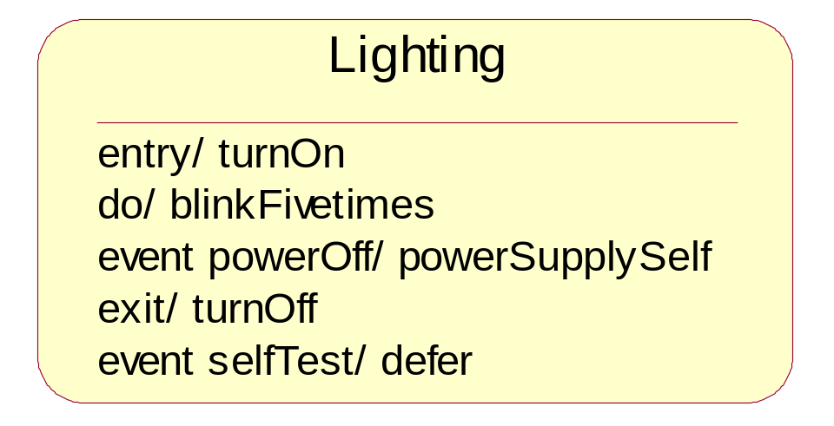
13.1.2.1 The Contents of State
Name | A textual string that distinguishes the state from other states; a state may be anonymous, meaning that it has no name
Entry/exit effects | Actions executed on entering and exiting the state, respectively
Internal transitions | Transitions that are handled without causing a change in state
Substates | The nested structure of a state, involving nonorthogonal (sequentially active) or orthogonal (concurrently active) substates
Deferred events | A list of events that are not handled in that state but, rather, are postponed and queued for handling by the object in another state

Slide 9
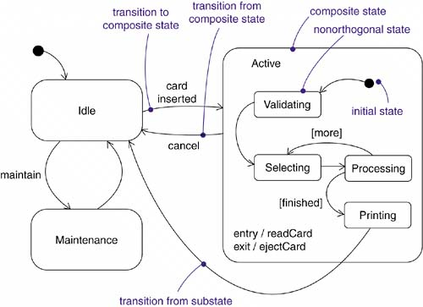
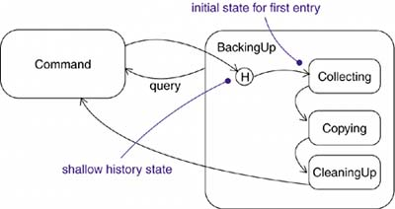
13.1.2.1 Classification of state
Initial state, final state, Composite state ,Substates, History state
In a state diagram, there is one and only one initial state. There may be one or more than one final states ,or none.
Initial and final states are really pseudo-states. Neither may have the usual parts of a normal state, except for a name
Notes:
左图中有三个状态： Idle, Maintenance 和 Active,其中 Active 是个 Composite state
右图 用来说明 History state: 在做备份时（Backingup)时，有三个 子状态，collecing, copying, cleaningUp, 在这个backingup 的过程中，随时都有可能中断去做其它事情， 通过 history state的记录，等再次进入时，可以继续上次断点处的工作，而不必从 头开始。

Slide 10
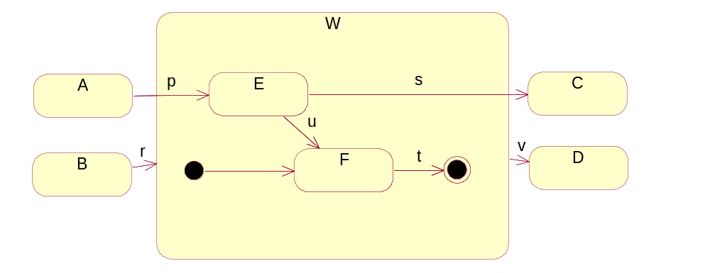
13.1.2.2 Composite state and Substates
A substate is a state that's nested inside another one
A state that has substates that are, nested states is called a composite state
  E，F is the substates of W
  W is the composite state
  Composite state can have initial and final state
Attention: the difference between transitions r and p，and the difference between transitions s and v

Slide 11
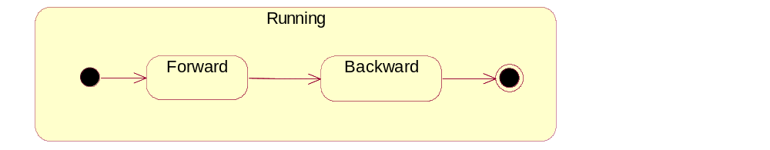
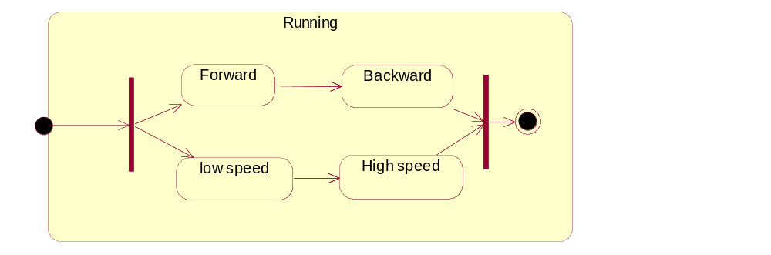
13.1.2.3 Relationships between substates
Non-orthogonal substates
  At a given moment, only one substate in the composite state can be reached
Orthogonal substates
  At a given moment, more than one substates in the composite state can be reached

Slide 12
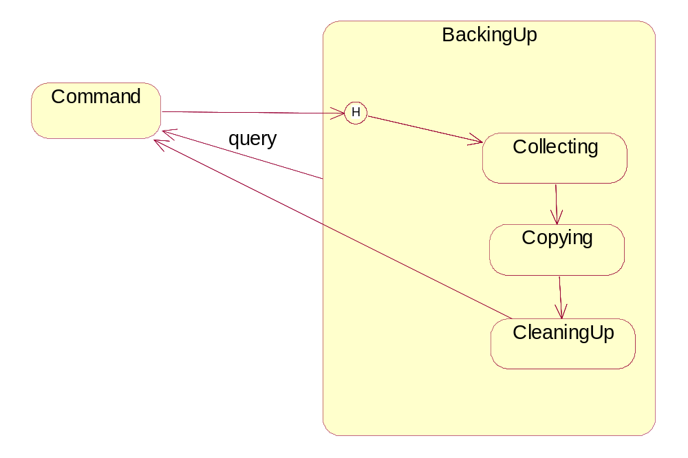
13.1.2.4 History state
Is a pseudo-state
Used to remember the last substate that was active prior to leaving the composite state to avoid beginning from the initial state again (Just used in composite states)
Examples

Slide 13
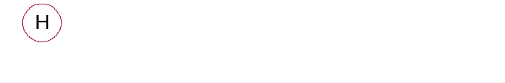
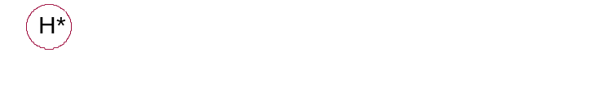
13.1.2.4 Classification of the history state
  Shallow history state： remembers only the history of the immediate nested state machine
  Deep history state： remembers down to the innermost nested state at any depth
If a nested state machine reaches a final state, it loses its stored history and behaves as if it had not yet been entered for the first time
How about without history states?? OK! with using flat state machines, but it's messy.
  For each sequential substate, you'd need to have its exit action post a value to some variable local to the composite state.
  The initial state to this composite state would need a transition to every substate with a guard condition, querying the variable

Slide 14
13.1.3 Transition
Is a relationship between two states indicating that an object in the first state will perform certain actions and enter the second state when a specified event occurs and specified conditions are satisfied
Event trigger | The event whose recognition by the object in the source state makes the transition eligible to fire, providing its guard condition is satisfied
Guard condition | A Boolean expression evaluated when the transition is triggered by the reception of the event trigger; if the expression evaluates true, the transition is eligible to fire. Otherwise, the transition does not fire, and if there is no other transition that could be triggered by that same event, the event is lost
Effect | An executable behavior, such as an action, that may act on the object that owns the state machine and indirectly on other objects that are visible to the object
Source state | The state affected by the transition; if an object is in the source state, an outgoing transition may fire when the object receives the trigger event of the transition and if the guard condition, if any, is satisfied
Target state | The state that is active after the completion of the transition

Slide 15
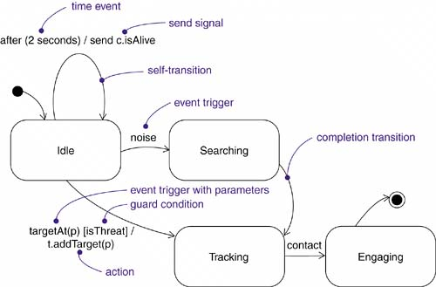
13.1.3 Transition
Expression of transition
  event-signature ‘[‘ guard-condition ‘]’ ‘/’ action
Event-signature
  event-name ‘(‘ comma-separated-parameter-list ‘)’
Example of transition expression
  targetAt(p) [isThreat] / t.addTarget(p)

Slide 16
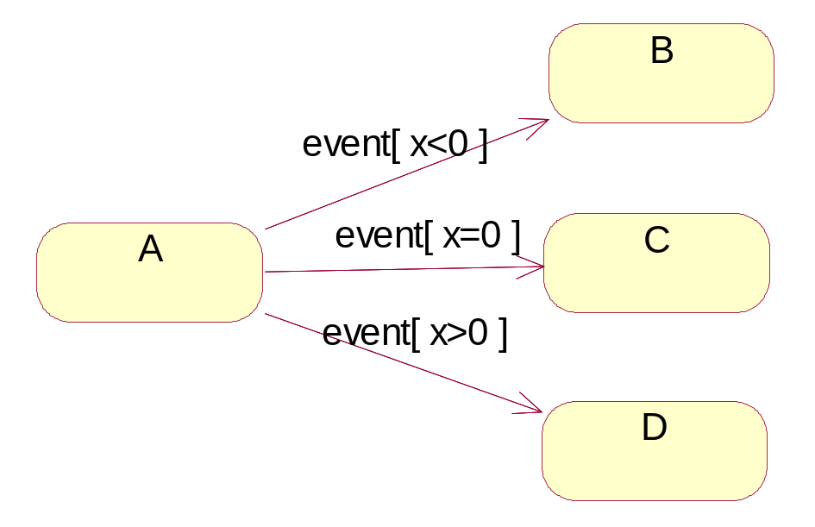
13.1.3 Transition
For a given state, only one transition can be produced. And the conditions of the transitions should be mutually exclusive
However, An event trigger may be polymorphic. For example, if you’ve specified a family of signals, then a transition whose trigger event is S can be triggered by S, as well as by any children of S.

Slide 17
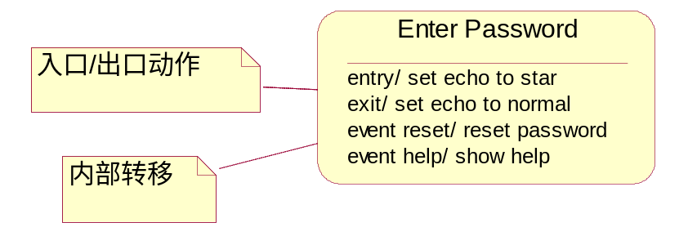
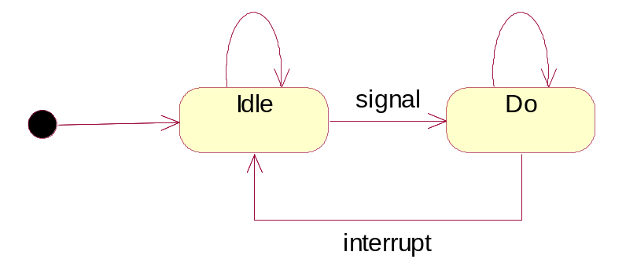
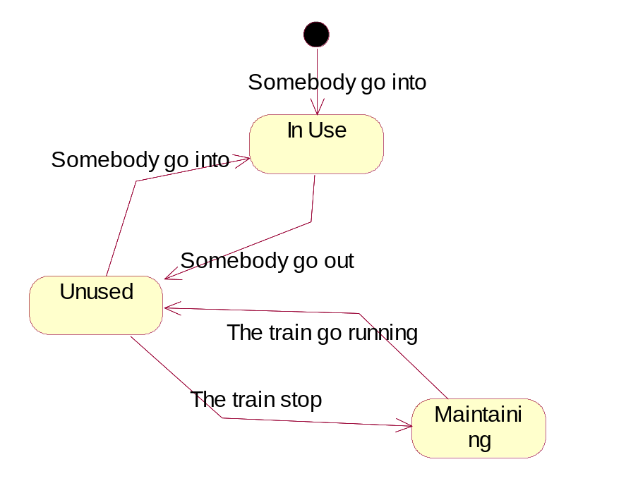
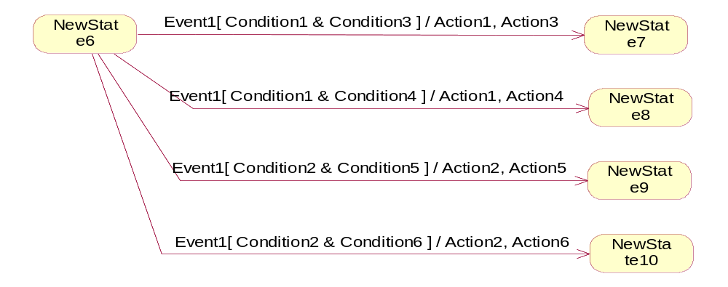
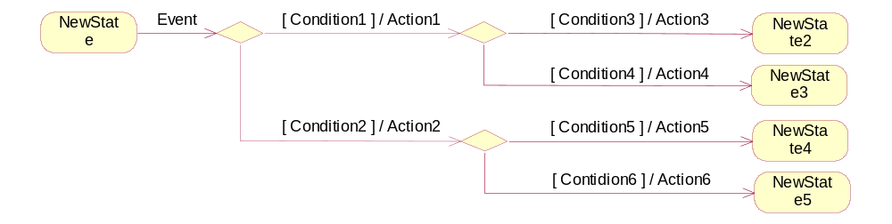
13.1.3 Transition types
External transition：most common → change the object states
Internal transition：not change the object state
Completion transition：Self- transition
Composite transition：made of simple transitions. Combined by branch, fork and join.
  Link branch
  Non-link branch
Notes:
Self-transition: In a self-transition, the source state and the target state are the same. In this case, all entry and exit actions are invoked, and a change of state is occurs.
Internal transition : In an internal transition, there is no target state. In this case, events can trigger an action on the transition, but no entry or exit actions are invoked, and no change of state will occur.

Slide 18
13.1.4 Event
An event is the specification of a significant occurrence that has a location in time and space
Events may be external or internal
  External: pass between the system and its actors
  Internal: pass among the objects that live inside the system -- overflow exception
Event can be divided into four kinds
  signal event：object receives a signal to trigger transition
  call event：call for operation
  change event：condition changed by the changed BOOLEAN expression
  time event：the time expression satisfied

Slide 19
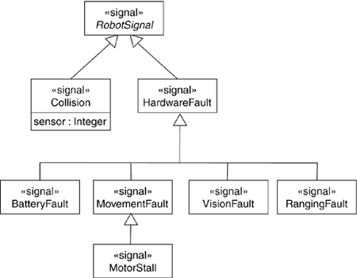
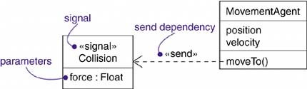
13.1.4.1 Signal event
Signal is a message type
  A message is a named object that is sent asynchronously by one object and then received by another
Signals is represented by stereotype of class <<signal>> :
  generalization relationships →hierarchies of events
  may have attributes and operations
Signal event means the object receives the signal, which will trigger state transition usually
You can use a dependency, stereotyped as send, to indicate that an operation sends a particular signal

Slide 20
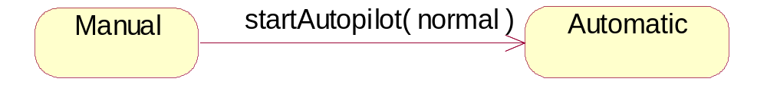
13.1.4.2 Call event
A call event represents the receipt by an object of a call request for an operation on the object. A call event may
  Trigger a state transition in a state machine
  Invoke a method on the target object
Format
  event-name ‘(‘ comma-separated-parameter-list ‘)’
Comparison of signal and call event:
  Signal event is asynchronous whereas Call event is synchronous;
  They have the same format
  Typically, a signal will be handled by its state machine, and a call event will be handled by a method

Slide 21
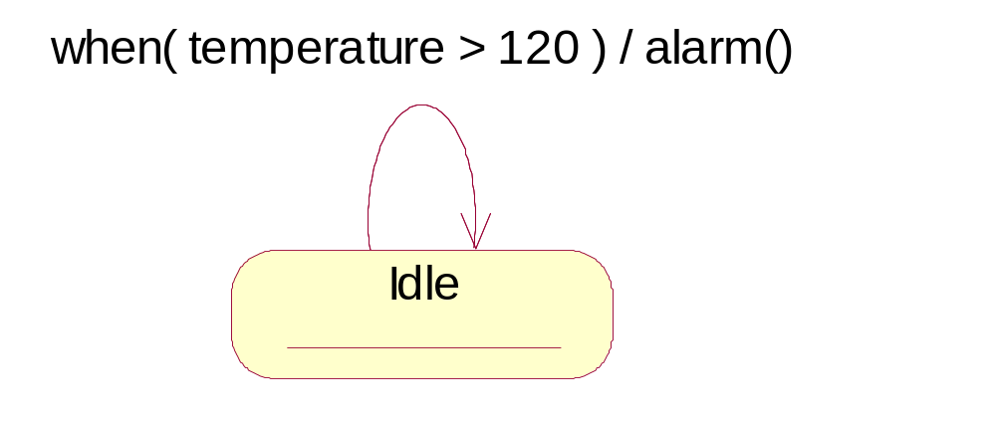
13.1.4.3 Change event
Represents a change in state or the satisfaction of some condition
Keyword “when”
A change event occurs once when the value of the condition changes from false to true. It does not occur when the value of the condition changes from true to false. The event does not recur while the event remains true.
Difference between change event and guard condition
  Guard condition is a part of transition. It will be calculated for one time when the related event occurs. If the value is false, state transition will not occur and it will not be re-calculated unless a new event occur again
  Change event represent an event needing to be tested again and again

Slide 22
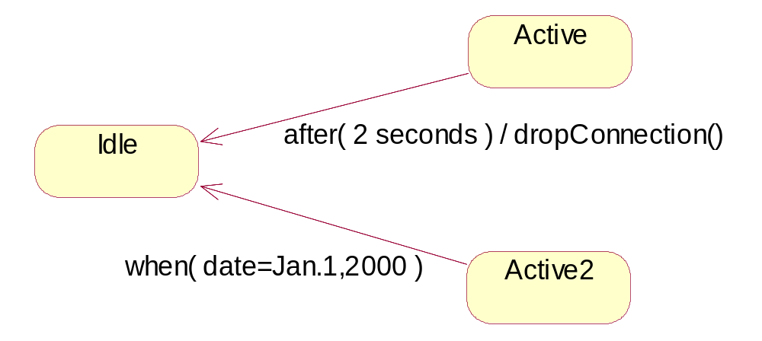
13.1.4.4 Time event
A time event is an event that represents the passage of time
Keyword “after” -- “after 2 seconds” “after 1 ms since exiting Idle”
Keyword “at ” OR “when”

Slide 23
13.1.4.5 Miscellaneous--Event <> Class/Object
Event will not occur without any object
Time event and change event involves one object
Signal event and call event involves at least two objects although they are not modeled in state machine:
  The object that sends the signal or invokes the operation and the object to which the event is directed
  the semantics of events interact with the semantics of active objects and passive objects
The call event that an object may receive is modeled as operations on the class of the object; the named signals that an object may receive is modeled by naming them in an extra compartment of the class

Slide 24
13.1.5 Action
Action is an executable computation that results in a change in state of the model or the return of a value
  Can’t be interrupted, and its execution time is neglectable
  There is no explicit syntax for action in UML
Two special action defined in UML：
  Entry action: Whenever you enter the state, its entry action is dispatched → ‘entry’ ‘/’ action-expression
  Exit action: whenever you leave the state, its exit action is dispatched → ‘exit’ ‘/’ action-expression
  entry / setMode(onTrack) exit / setMode(offTrack)

Slide 25
13.2 Activity diagram—introduction
Model the dynamic aspects of systems
Essentially a flowchart, showing flow of control from activity to activity showing sequence and concurrency as well as branches of control
Different from interaction diagrams emphasizing the flow of control from object to object, activity diagrams emphasize the flow of control from step to step
Can construct executable systems through forward and reverse engineering

Slide 26
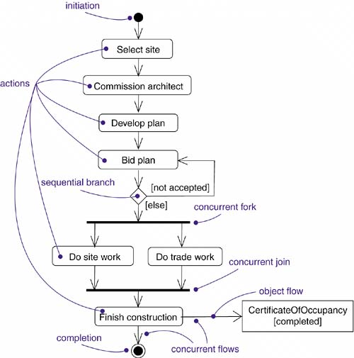
13.2.1 Activity diagram- basic concepts
  Action / Activity node
  Initial node/final node
  Flow/edge
  Condition
  Branch
  Fork&join
  Decision/Merge
  swimlane

Slide 27
13.2.1.1 Activity
Action
  Action is atomic and thus can’t be decomposed any more
  cannot be executed partly
  the work of an action is often considered to take insignificant execution time
  The goal of action is to execute entry action and then change to another state
Activity nodes are nested groupings of actions or other nested activity nodes
  have visible substructure
  Is decomposable, (non-atomic) ，take some duration to complete
  An action can be regarded as a special case of an activity node

Slide 28
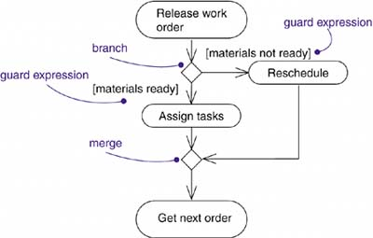
13.2.1.2 Branch & Merge
Used to specify alternate paths taken based on some Boolean expression.
  Guards on the outgoing flows should not overlap
  Should cover all possibilities
No guards are necessary on merge

Slide 29
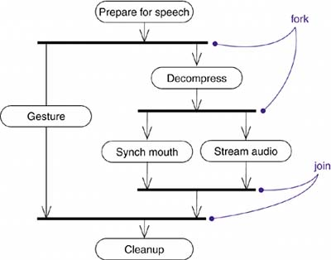

13.2.1.3 Folk & Join
Forking and joining are used to specify the parallel flows of control.
Fork
  Have one incoming transition and two or more outgoing transitions, each of which represents an independent flow of control
  Below the fork, the activities of these paths continue in parallel
Join
  Synchronize the concurrent flows→each waits until all incoming flows have reached the join
  one flow of control continues on below the join
Attention : Joins and forks should balance → The number of flows that leave a fork should match the number of flows that enter its corresponding join

Slide 30
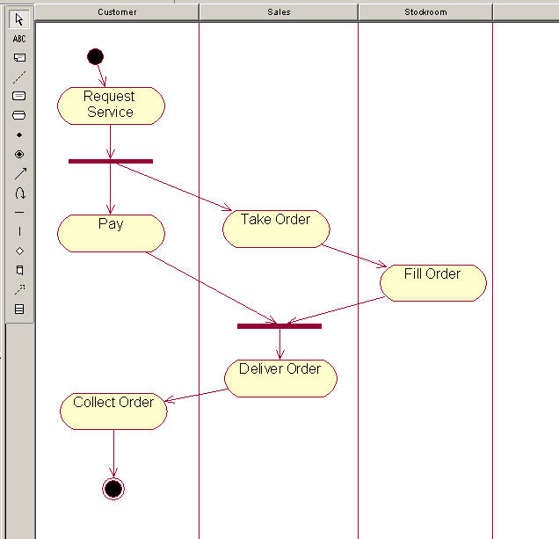
13.2.1.4 Swimlane
For a relatively large object, say, the whole system, there will be a lot of roles that join in the activities. How to divide and organize???
  Swimlane → each swimlane represents a high-level responsibility for part of the overall activity of an activity diagram
  each swimlane may eventually be implemented by one or more classes. However, swimlane focuses on the responsibility, is not corresponding to the class one to one.

Slide 31
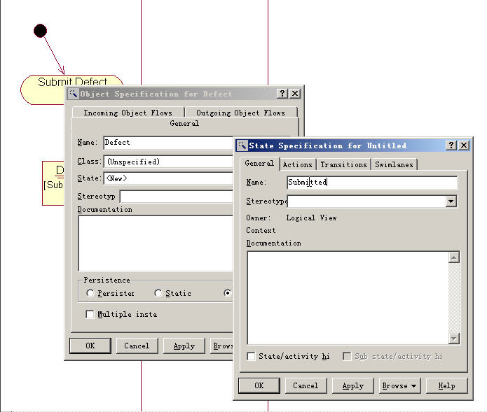
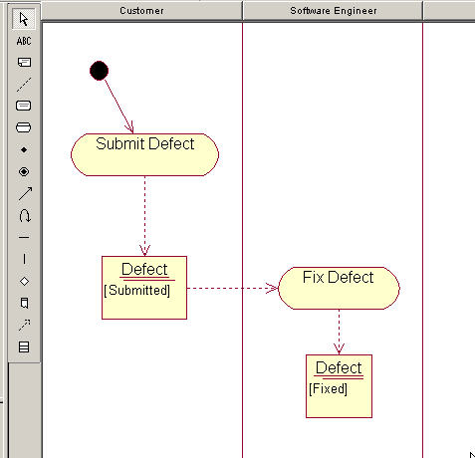
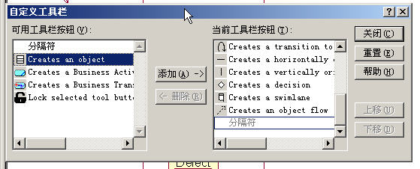
13.2.2 Object flow
Objects may be involved in the flow of control associated with an activity diagram
  Object flow represents the relationship between the activity and object：
    An activity create an object (as output of the activity)
    The used object（as input of the activity）
Object flow belongs to control flow
  An object flow inherently implies control flow (you can't execute an action that requires a value without the value!), so it is unnecessary to draw a control flow between actions connected by object flows.

Slide 32
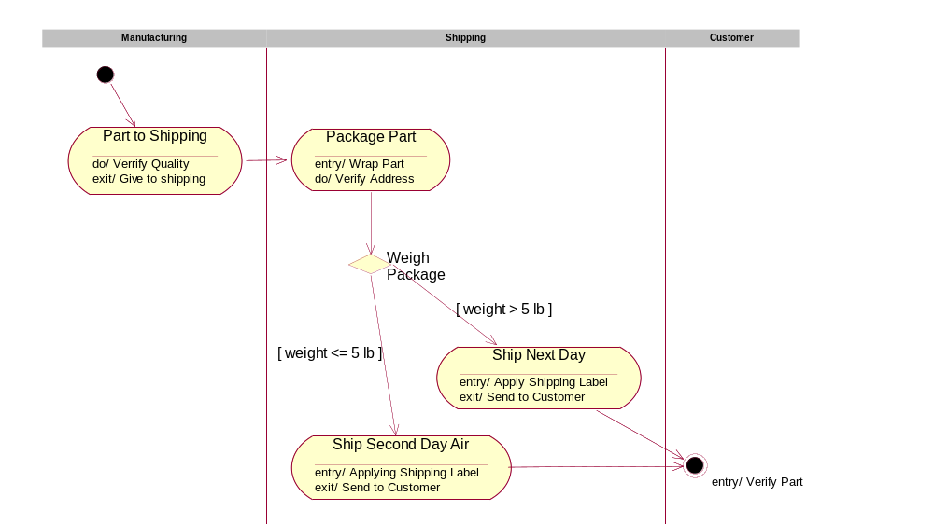
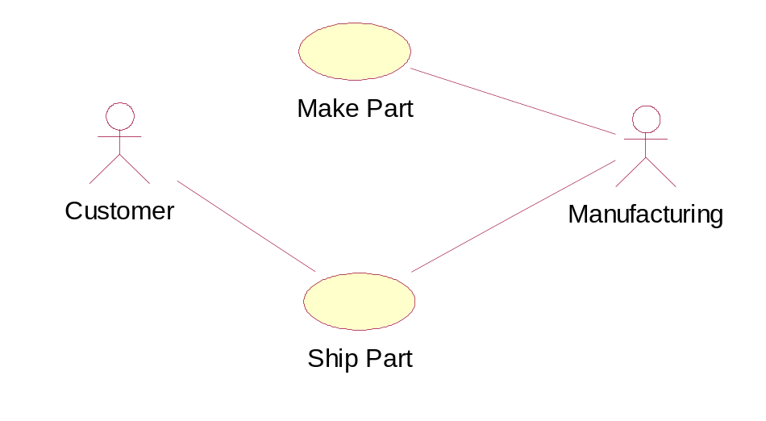
13.2.2 Common use of activity diagram
Used in the context of the system as a whole, a subsystem, an operation, or a class
Attached to use cases (to model a scenario) and to collaborations (to model the dynamic aspects of a society of objects).
Typically in two ways:
  To model a workflow
    activities as viewed by the actors that collaborate with the system
    Workflows are used to visualize, specify, construct, and document business processes
    modeling object flow is particularly important

Slide 33
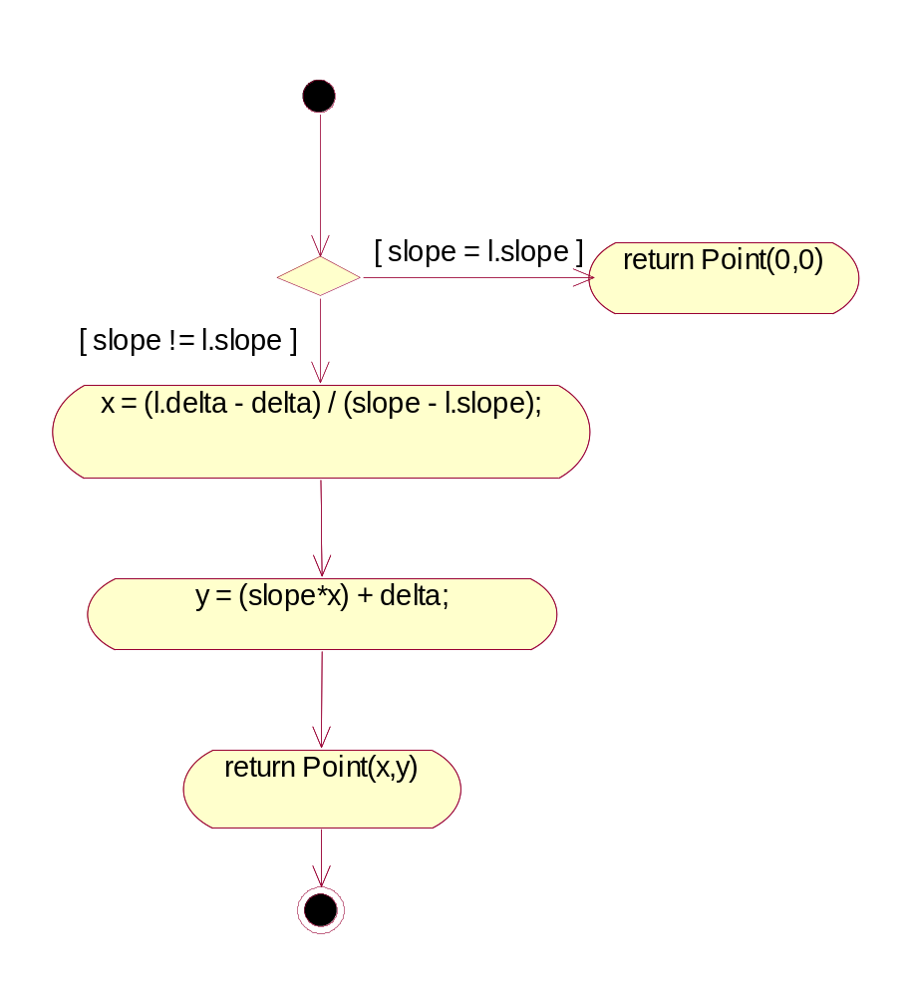
13.2.2 Common use of activity diagram
To model an operation
  Used as flowcharts to model the details of a computation
  the modeling of branch, fork, and join states is particularly important
Page <number>

Slide 34
13.2.3 Forward and Reverse Engineering
Forward engineering is possible for activity diagrams, especially if the context of the diagram is an operation.
For example, C++ code can be generated for the operation intersection as follows:
Point Line::intersection (line : Line)
{
if (slope == line.slope)
return Point(0,0);
int x = (line.delta - delta) / (slope - line.slope);
int y = (slope * x) + delta;
return Point(x, y);
}
A bit of cleverness here, involving the declaration of the two local variables

Slide 35
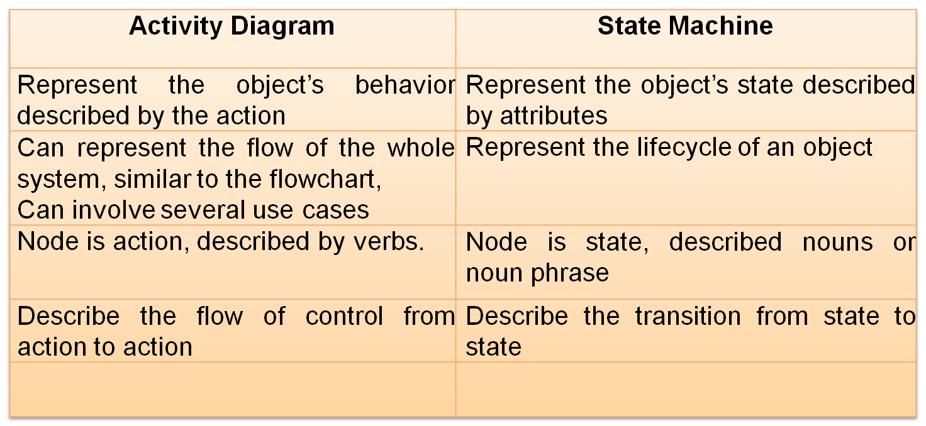
13.2.4 Comparison of activity and state machine diagram
Both of them are not suitable for the interaction among several objects which can be described by sequence diagram and collaboration diagram

Slide 36
13.2.5 Conclusion of statechart and activity diagram
StateChart
  Describe the states of the object and the transition between states
  Basic Concepts：
    State; Composite state; substate; history state; transition; event ; action
Activity diagram
  Describe the workflow and concurrent behaviors of the system or detailed algorithm of an operation
  Basic Concepts:
    Activity; swimlane; branch; fork; Join; object flow……
In UML，the event can be divided into call event; change event; time event and signal event
The forward and reverse engineering can be applied for statechart and activity diagram. However, it is not an easy task even if there are the tool’s help
They are both used for behavior modeling. And they are similar. However, they are used in different situations

Slide 37
13.3 Component diagram
13.3.1 Basic concepts: Component, artifact,
13.3.2 Difference between component and class, between component and artifact
13.3.3 Other basic concepts: interface, port, connector, internal structure
13.3.4 Introduction of Component diagram
13.3.5 Conclusion

Slide 38
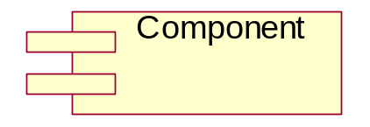
13.3.1 Component & Artifact
A Component represents a modular part of a system, that encapsulates its content and whose manifestation is replaceable within its environment. A component defines its behavior in terms of provided and required interfaces
  A component may be replaced by another if and only if their provided and required interfaces are identical
  No restriction on the granularity of a component. A component may be as small as a figure-to-word converter, or as large as an entire document management system

Slide 39
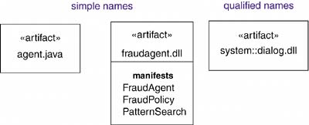
13.3.1 Component & Artifact
An artifact is a physical part of a system that exists at the level of the implementation platform. Graphically, an artifact is rendered as a rectangle with the keyword «artifact».
Examples of artifacts include model files, source files, scripts, and binary executable files, a table in a database system, a development deliverable, or a word-processing document, a mail message
  artifacts are the physical entities that are deployed on Nodes, Devices, and Execution Environments.

Slide 40
13.3.1 Difference between component and class
Class is a logical abstraction whereas component is a physical abstraction, which can live on nodes
Component is the physical realization of the other logical elements such as class, collaboration
Class can have attribute and operation. Component often has operation which can be used only by interface

Slide 41
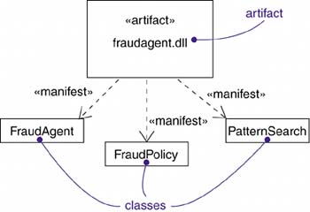
13.3.2 Difference between artifact and class
Classes and artifacts are both classifiers
Classes represent logical abstractions; artifacts represent physical things that live in the world of bits. In short, artifacts may live on nodes, classes may not
Artifacts represent the physical packaging of bits on the implementation platform
Classes may have attributes and operations. Artifacts may implement classes and methods, but they do not have attributes or operations themselves
Components are implemented by artifacts

Slide 42
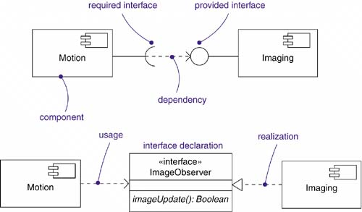
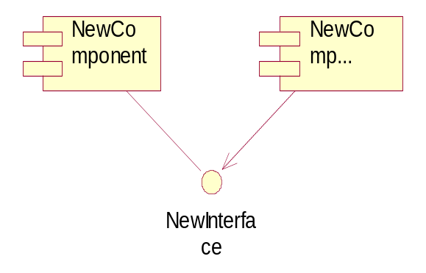
13.3.3 Interface
  A collection of operations that specify a service that is provided by or requested from a class or component.
  Interfaces are used as the glue to bind components together in component based system modeling
  Breaks the direct dependency between the components
Provided interface
Required interface
Relationship between interface and component
  Dependency
  Realization

Slide 43
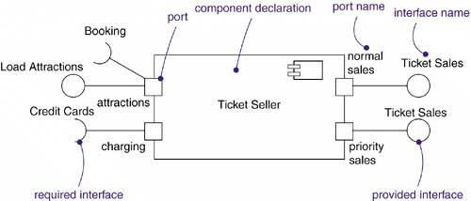
The advantage of ports and interfaces is that the two components don't have to know about each other at design time, as long as their interfaces are compatible
13.3.3 Port
A port is an explicit window into an encapsulated component
  Accepting messages to and from the component conforming to specified interfaces
  The externally visible behavior of the component is the sum of its ports, no more and no less
  Permit the interfaces of a component to be divided into discrete packets and used independently. The encapsulation and independence provided by ports permit a much greater degree of encapsulation and substitutability.
  Ports are part of a component. Instances of ports are created and destroyed along with the instance of the component to which they belong
  Ports may also have multiplicity

Slide 44
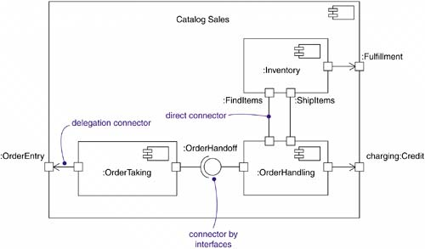
13.3.3 Connector
Connector: A wire between two ports to connect two components
  In an instance of the overall component, it represents a link or a transient link.
  A link is an instance of an ordinary association. A transient link represents a usage relationship between two components.
Show connectors in two ways:
  Directly: just draw a line between them or their ports
  Through ports: ball-and-socket notation
      No inherent relationship between the components, although they are connected inside this component. You could substitute some other component that satisfies the interface

Slide 45
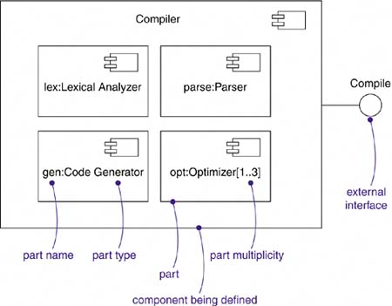
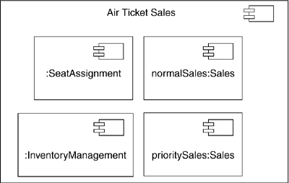
13.3.3 Internal Structure & Part
A Part is a unit of the implementation of a component.
  A part has a name and a type
  A part has a multiplicity within its component
The internal structure of a component is the parts that compose the implementation of the component together with the connections among them. In many cases, the internal structure can be instances of smaller components that are wired together statically through ports to provide the necessary behavior without the need for the modeler to specify extra logic
Note: parts can correspond to artifacts

Slide 46
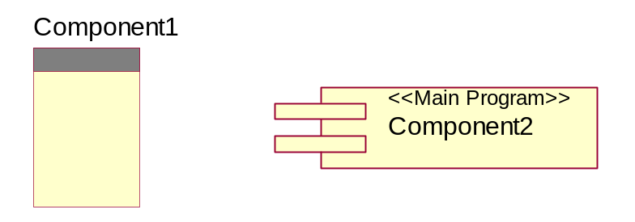
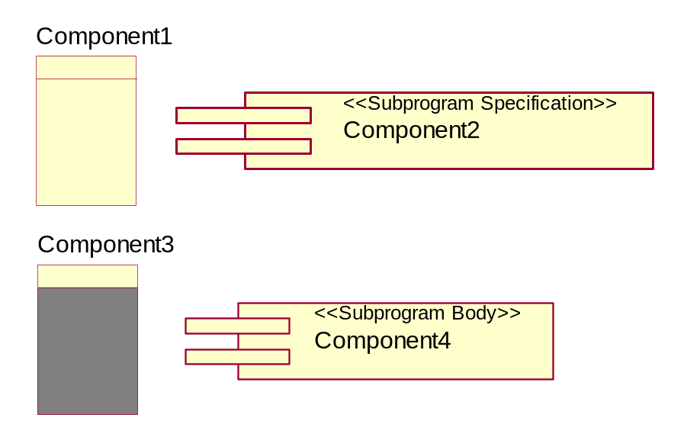
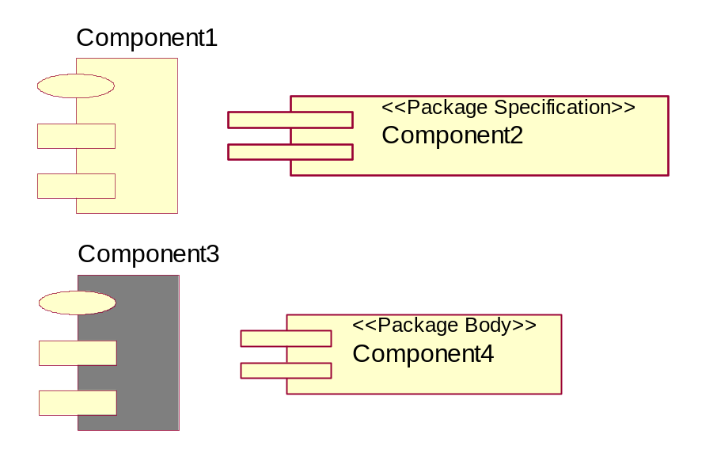
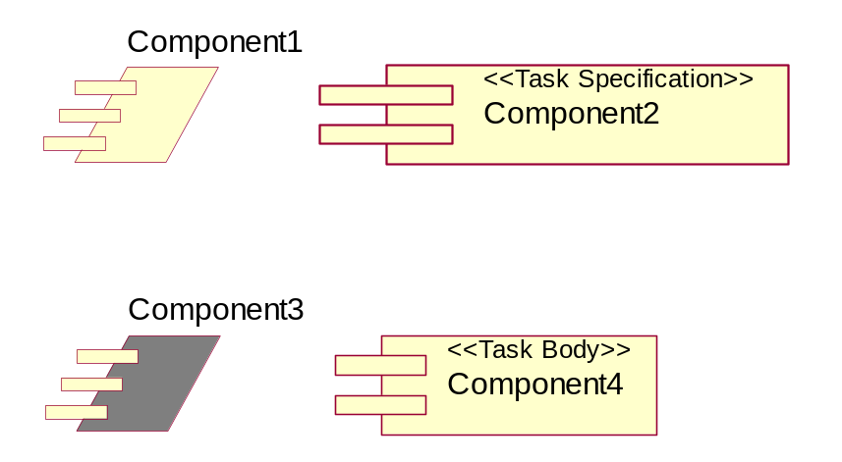
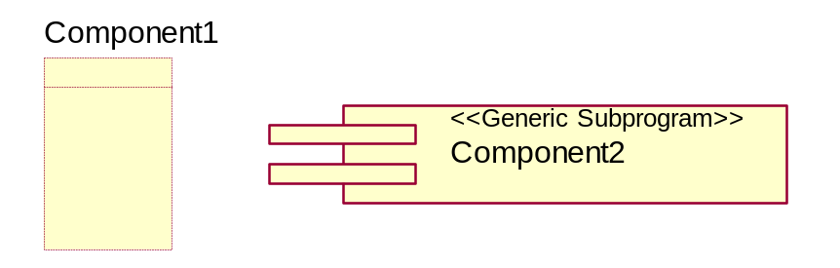
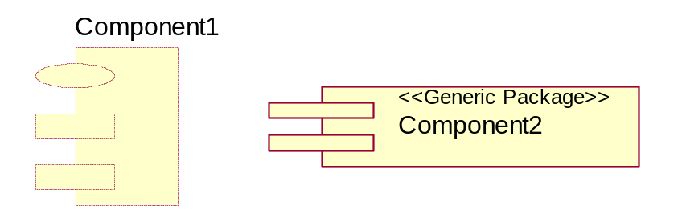

13.3.3 Stereotypes of component
Main Program
Subprogram Specification / Subprogram Body
Package Specification / Package Body
Task Specification / Task Body
Generic Subprogram
Generic Package
Database

Slide 47

13.3.3 Component package
Includes a group of logically-related components and/or main components of the system. It is similar to the logical package for class diagram.
  A programming language-neutral way of referring to class container
Usually the name of component package is the path of the file system, such as: System.Web.UI, java.util
Rendered as follows

Slide 48

13.3.4 Component diagram
Depicts how components are wired together to form larger components and/or software systems. They are used to illustrate the structure of arbitrarily complex systems

Slide 49
13.3.5 Conclusion
Component is used to represent a concrete physical element
Component diagram is used to display a group of components and their relationships
Component diagram can be used to model the relationship between source code files, execution files
With the help of tools, the generated code can be controlled by the component diagram in forward engineering. Meanwhile, the component diagram and class diagram can be obtained by the source code in reverse engineering

Slide 50
13.4. Deployment diagram
13.4.1 Introduction of deployment diagram
13.4.2 Node: processor and device
13.4.3 Connector
13.4.4 Examples

Slide 51

13.4.1 Deployment diagram
models the physical deployment of artifacts on nodes.
  Used for physical modeling of the system
There is only one deployment diagram for a system. It can help the designer to understand the distributed system
Two main elements in deployment diagram
  Node
  Connection

Slide 52

13.4.2 Node
A physical element that exists at run time
Represents a computational resource, generally having at least some memory and, often, processing capability. Graphically, a node is rendered as a cube. UNIX host, PC, printer, sensor, etc
Name:
  Simple name
  Qualified name

Slide 53

13.4.2 Comparison of node and artifact
Both have names
Both may participate in dependency, generalization, and association relationships
Both may be nested
Both may have instances
Both may be participants in interaction
sameness
Stereotype of class
Artifacts are things that participate in the execution of a system; nodes are things that execute artifacts
Artifacts represent the physical packaging of otherwise logical elements; nodes represent the physical deployment of artifacts
difference

Slide 54


13.4.2 Node: Processor & Device
A processor is a node that has processing capability, meaning that it can execute an artifact
  Furthermore, what processes, the priority of each process, process scheduling mode, etc.
    Scheduling mode: preemptive, non-preemptive, cyclic, executive, manual, etc
A device is a node that has no processing capability (at least, none that are modeled at this level of abstraction) and, in general, represents something that interfaces to the real world For example, MODEM, Terminal, etc.

Slide 55


13.4.3 Connector
Is an association relationship between nodes.
  Since it is an association, thus can include roles, multiplicity, and constraints, etc.
Some common connections: Ethernet connection, a serial line, or a shared bus, indirect connections, such as a satellite link

Slide 56


13.4.4 Examples

Slide 57
13.4.5 Conclusion
Deployment diagram can be used to show the topological structure, communication path and soft artifacts on the nodes of the system
There is only one deployment diagram for a system.
Node can be divided into two kinds: processor and device
Connection is the association between two nodes
Deployment diagram is very helpful for understanding the physical structure of the complex system

